Slide 1
ALY 6980 CAPSTONE PROJECT
Group 3
Pei-Yu Jheng, Shreeya Ambre, Sean Mclean, Theodore Smith

Slide 2

Introduction
Data Cleaning & Integration: Ensure accurate and consistent datasets.
Streamlit Dashboard: Track customer interactions efficiently.
Growth Optimization: Prioritize high-potential opportunities.

Slide 3
BUSINESS QUESTION
Utilizing past data, how can Big Sky improve leads and transactions by building stronger client relationships?

Slide 4
Tools and Data To Use
R and Python for Data Cleanup
Interactive Dashboard for Assessment and Edits
Comparison of datasets for industry research

Slide 5
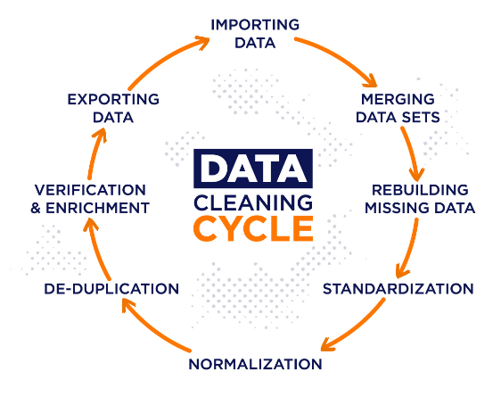
Data Cleaning Process
Statistical Overview: Print table stats and identify missing values.
Merging: Combine datasets and ensure smooth integration.
Column Name Standardization: Convert to lowercase, replace spaces/dots with underscores.
Duplicate Columns: Identify and distinguish duplicates.
Unnecessary Columns: Remove irrelevant columns (e.g., id, "last enriched time").
Finding Missing Values

Slide 6

Exploratory Data Analysis
Identify Trends & Patterns: Focus on key attributes to target potential clients.
External Datasets Comparison: Evaluate similar external datasets for added insights.
Variable Relationships: Examine correlations for business insights and addressing concerns.

Slide 7
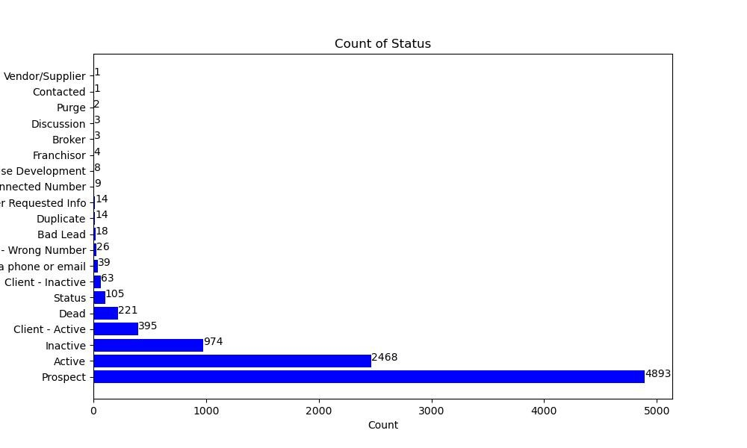
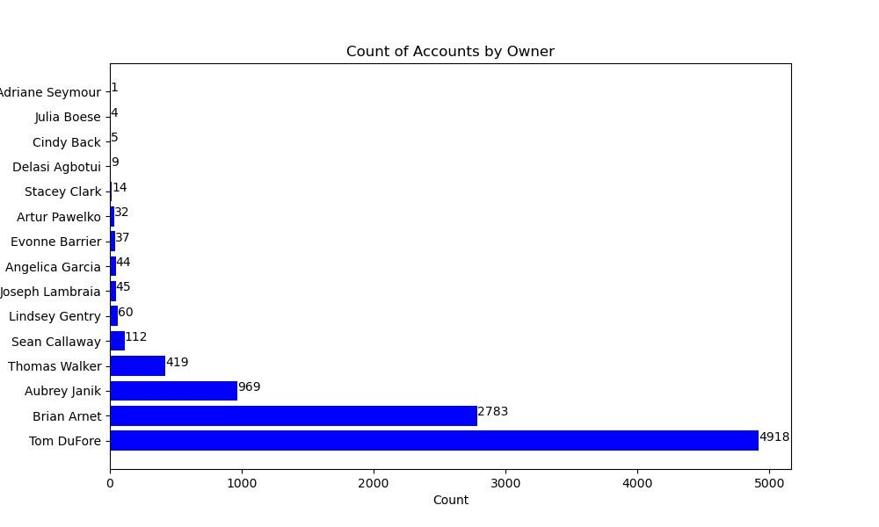
Exploratory Data Analysis (Cont.) - Client Accounts

Slide 8
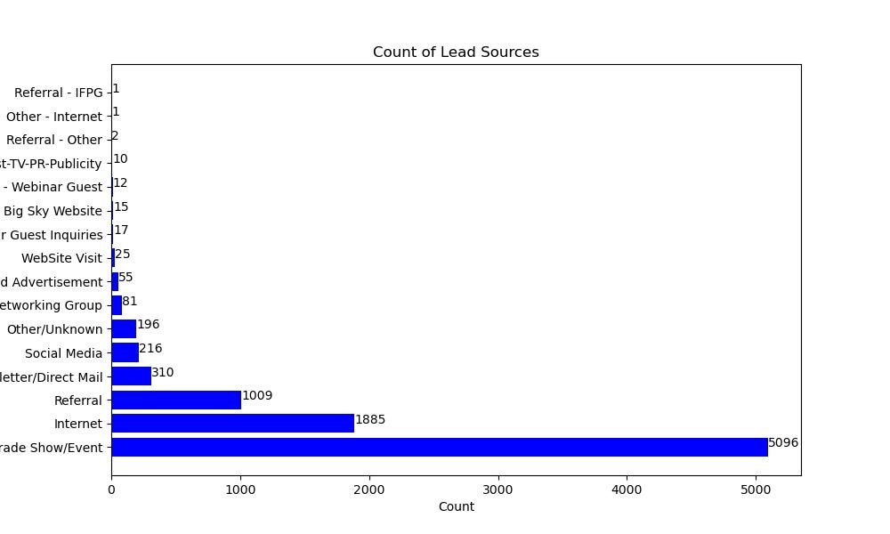
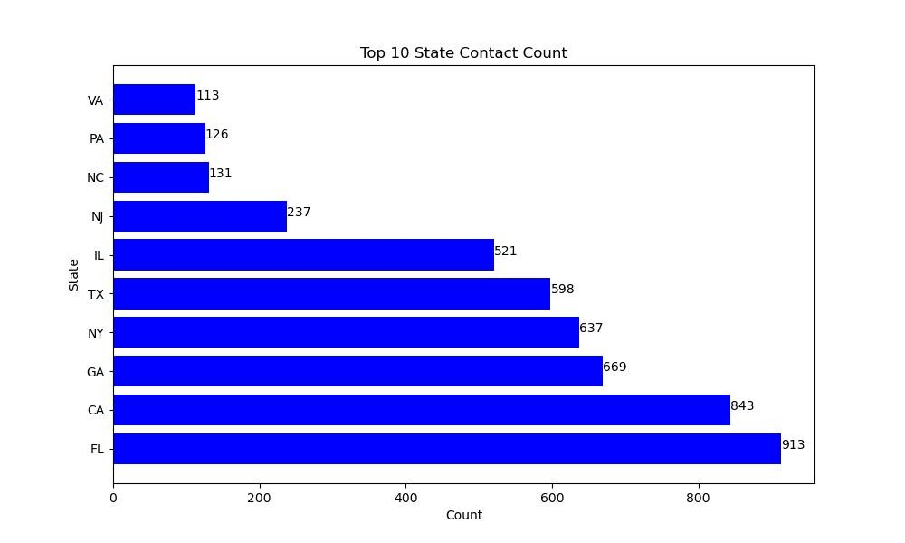
Exploratory Data Analysis (Cont.) - Leads and Contacts

Slide 9

Key Questions & Issues to Address
Focus Areas for Client Acquisition:
Our analysis will highlight key areas to focus on for landing more clients.
Inquiry-to-Callback Time:
What is the average, minimum, and maximum number of days from inquiry to callback?
Business Relationship Stages:
Count the number of “probabilities” in the dataset, which may represent stages in business relationship development.
State/Region Impact:
Do certain states or regions influence the number of inquiries and probabilities in the dataset?

Slide 10

Final Words/What To Expect
Construction of customer management accounts.
Data collection methods to gain important metrics.
Creation of Interactive dashboard on data insights.
Plan and solutions for long-term growth.

Slide 11

Concluding Thoughts
Opportunity to improve internal process.
The implementation of data governance.
Forward-focus plan for Big Sky.
The rise of new leads.

